Slide 1

VLSI Design and Implementation of Two Dimensional FIR filter architectures using CSD
Names of students
A. Pavan Kumar (19B81A0430)
D. Jahnavi (19B81A0414)
M. Surya Vardhan (19B81A0449)
Under the Guidance
Dr. Venkata Krishna Odugu
Associate Professor,
ECE Dept.

Slide 2
ABSTRACT
The 2D FIR filter is commonly used in image processing applications such as image restoration, image filtering, image sharpening and smoothing, etc.
The existing 2D FIR filter architecture using more number of multipliers, adders & subtractors which leads to more power and area.
To reduce the number of multipliers, the symmetry is incorporated in the filter coefficients while designing the filter.
To optimize the filter architecture, the Canonic Signed Digit (CSD) number format is considered to represent the filter coefficients.
The VLSI architecture of symmetry 2D FIR filter is implemented using Fully Direct form.

Slide 3
OBJECTIVE
To design an efficient symmetry 2D FIR filter using Kth-McClellan Transform technique.
To represent the filter coefficients in CSD format to replace the conventional multiplication process and to reduce the number of adders.
To design area-delay-power efficient VLSI architecture in the Fully Direct form.

Slide 4


LITERATURE SURVEY
Name | Year Proposed | Methods Proposed | Drawbacks
Mohanty, B. K., Meher, P. K., Al - Maadeed & Amira. | 2013 | The memory-efficient 2D FIR filters in-separable and non-separable structures. | Multipliers are complex blocks and occupies more area and consumes large power.
Bindima and Elias | 2016, 2017, 2019 | Low complex circular and fan type 2D FIR filter design. | Focused on the design of higher-order filters and the design required a huge number of multipliers.

Slide 5
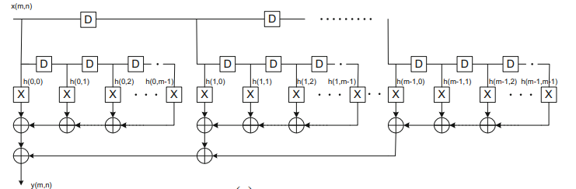
ARCHITECTURE OF DIRECT FORM FIR FILTER
Fig: General Architecture of 2D FIR filters Fully Direct form

Slide 6
CANONICAL SIGNED DIGIT REPRESENTATION
Encoding a binary number such that it contains the fewest number of non-zero bits is called Canonical Signed Digit (CSD).
The digital multiplication using CSD converted numbers is faster than using conventional digital numbers.
Properties of CSD numbers:
No 2-consecutive bits in a CSD number are non-zero.
Signed-digit binary uses three symbols in each power-of-two position: -1, 0, 1
The CSD representation of a number contains the minimum possible number of non-zero bits, thus the name canonical.
The CSD form contains 33% less non-zero digits than the binary presentation (on average).

Slide 7
CANONIC SIGNED DIGIT EXAMPLE
Example : Lets take for example a number 287, which is 1 0001 1111 in binary representation. (256 + 16 + 8 + 4 + 2 + 1 = 287)
1 0001 1111
Starting from the right (LSB), if you find more than non-zero elements (1 or -1) in a row, take all of them, plus the next zero. (if there is not zero at the left side of the MSB, create one there). We see that the first part of this number is,
01 1111
Add 1 to the number (i.e. change the 0 to 1, and all the 1's to 0's), and force the rightmost digit to be -1
01 1111 -> 10 000-1
You can check that the number is still the same: 16 + 8 + 4 + 2 + 1 = 31 = 32 + (-1). Now the number looks like this
1 0010 000-1
Since there are no more consecutive non-zero digits, the conversion is complete. Thus, the CSD presentation for the number 287 is 1 0010 000-1, which is 256 + 32 - 1.

Slide 8
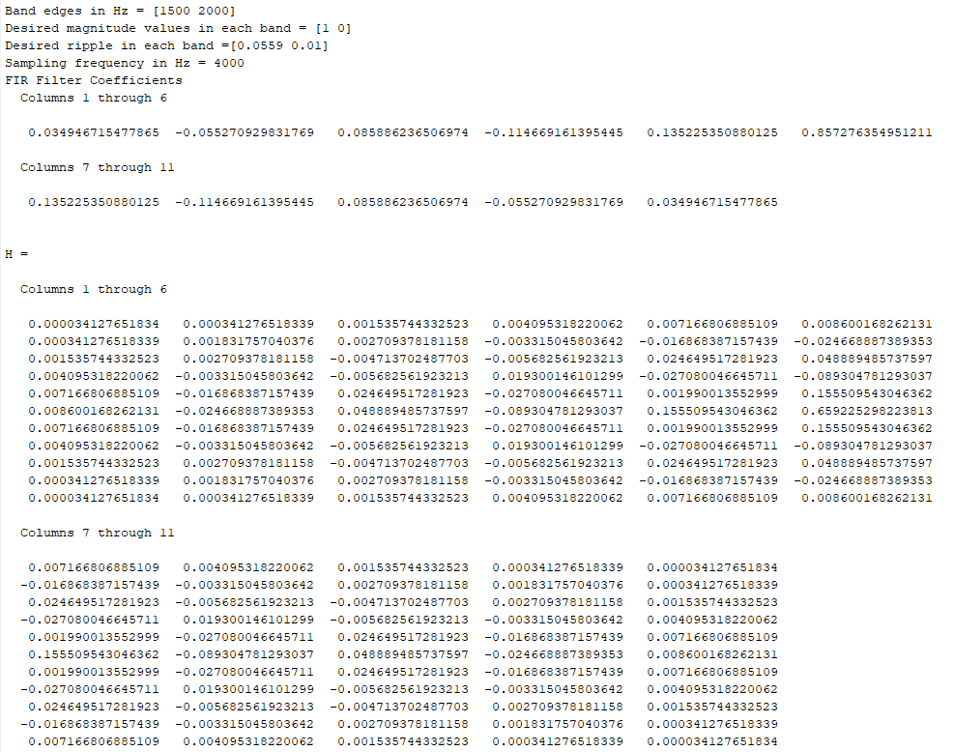
FIR Filter Coefficients for order 11

Slide 9
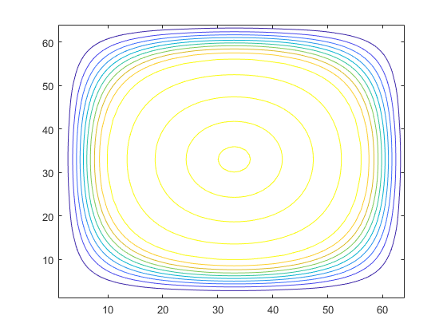
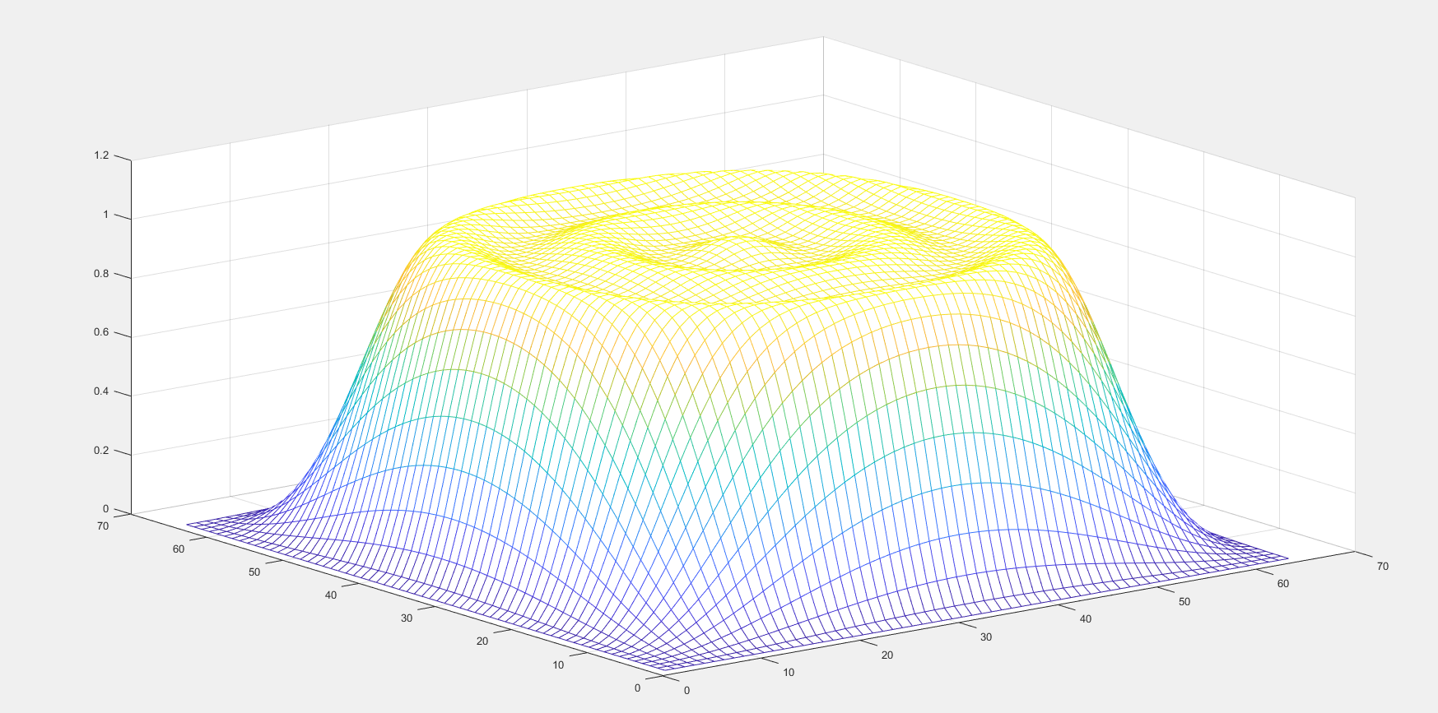
Fig: Frequency response of Low Pass FIR Filter
Fig: Contour of Low Pass FIR Filter

Slide 10
WHY CSD?
 | Filter Coefficients | Binary Representation | CSD Representation
1. | 0.00034127651834 | 0.0000000000010110011 | .00000000000+1
2. | 0.000341276518339 | 0.0000000000010110011 | .00000000000+1
3. | 0.001535744332523 | 0.0000000001100100101 | .00000000+10-10
4. | 0.004095318220062 | 0.0000000100001100011 | .0000000+10000
5. | 0.007166806885109A | 0.00000001110101011011 | .000000+100-10+1
6. | 0.008600168262131 | 0.0000001000110011101 | .000000+100+10-1
7. | 0.007166806885109 | 0.00000001110101011011 | .000000+100-10+1
8. | 0.004095318220062 | 0.0000000100001100011 | .0000000+10000
9. | 0.001535744332523 | 0.0000000001100100101 | .00000000+10-10
10. | 0.000341276518339 | 0.0000000000010110011 | .00000000000+1
11. | 0.00034127651834 | 0.0000000000010110011 | .00000000000+1
Total Multiplier |  | 72 | 22

Slide 11
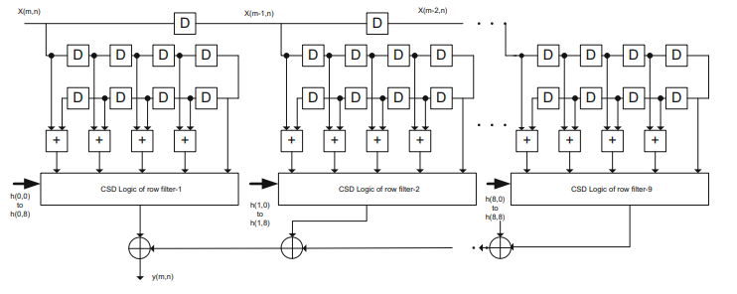
FILTER ARCHITECTURE USING CSD
Fig: The architecture of 2D FIR filter in the fully direct form using CSD coefficients

Slide 12
ROW FILTER-1 CSD CODE
 | Filter Coefficients | CSD Representation
H(0, 0) =H(0, 10) | 0.000341276518339 | .00000000000+1
H(0, 1) =H(0, 9) | 0.001831757040376 | .00000000+100-1
H(0, 2) =H(0, 8) | 0.002709378181158 | .0000000+10-10-1
H(0, 3) =H(0, 7) | -0.003315045803642 | .0000000-10+10-1
H(0, 4) =H(0, 6) | -0.016868387157439 | .00000-1000-10-1
H(0, 5) | -0.024668887389353 | .0000-10+100-10-1

Slide 13
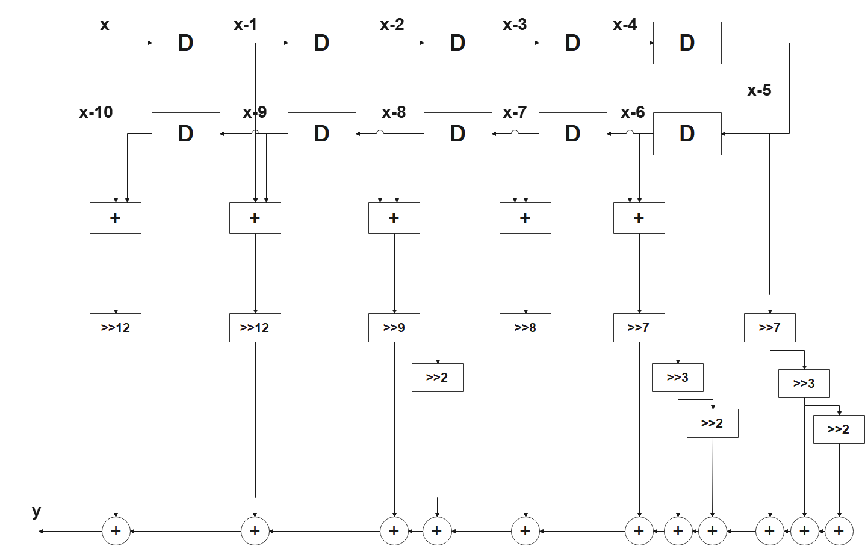
The FIR filter equations and architectures generated from the obtained filter coefficients following MATLAB simulation by giving the desired filter specifications are expressed below.
Row Filter 1 : Y = [x+(x-10)]>>12 + [(x-1)+(x-9)]>>12 +[(x-2)+(x-8)]>>9 - [(x-2)+(x-8)]>>11+[(x-3)+(x-7)]>>8 +[(x-4)+(x-6)]>>7 –[(x-4)+(x-6)]>>10 +[(x-4)+(x-6)]>>12 +[(x-5)]>>7 +[(x-5)]>>10 -[(x-5)]>>12
Fig: Architecture of FIR filter in the direct form using CSD coefficients for row-filter 1

Slide 14
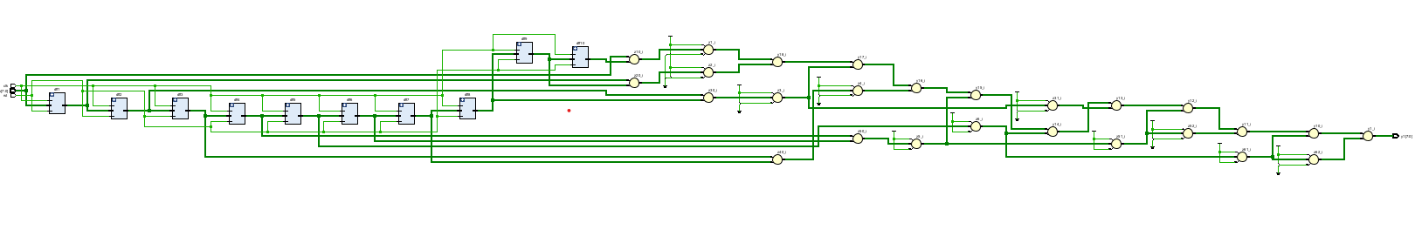
RTL SCHEMATICS OF ROW FILTERS
Fig: RTL Schematic of row filter 1

Slide 15
ROW FILTER-2 CSD CODE
 | Filter Coefficients | CSD Representation
H(1, 0) =H(1, 10) | 0.000341276518339 | .00000000000+
H(1, 1) =H(1, 9) | 0.001831757040376 | .00000000+00-
H(1, 2) =H(1, 8) | 0.002709378181158 | .0000000+0-0-
H(1, 3) =H(1, 7) | -0.003315045803642 | .0000000-0+0-
H(1, 4) =H(1, 6) | -0.016868387157439 | .00000-000-0-
H(1, 5) | -0.024668887389353 | .0000-0+00-0-

Slide 16
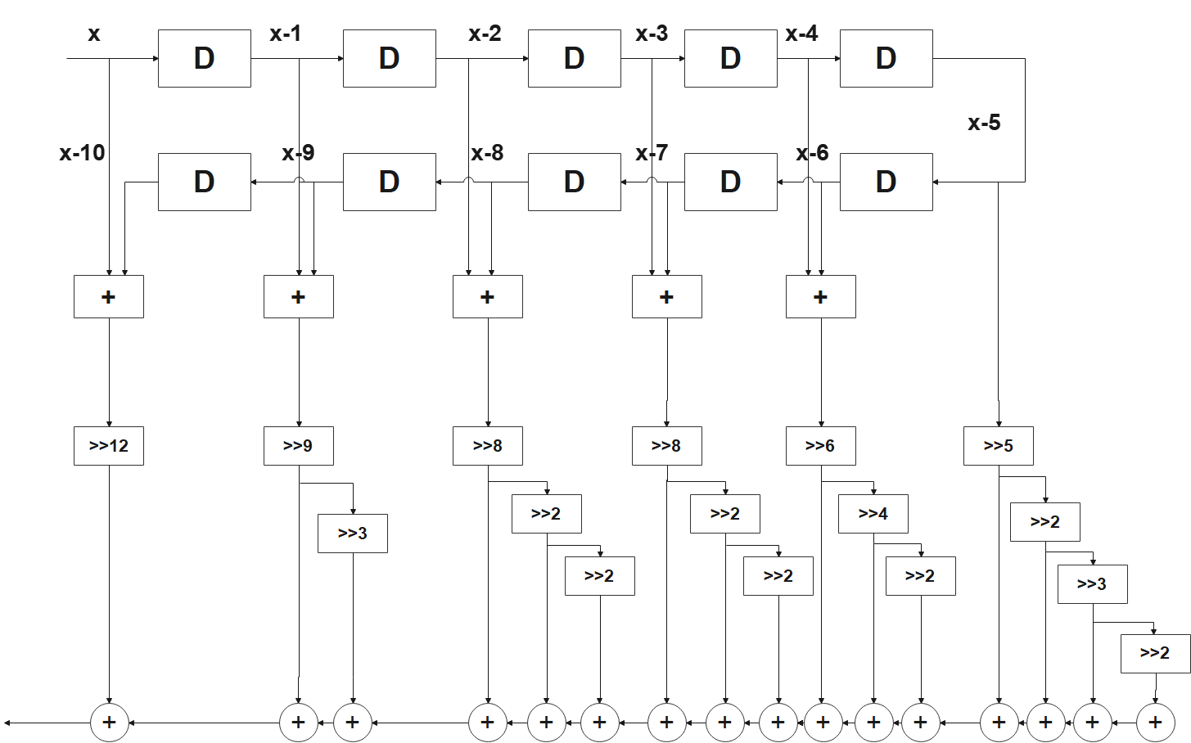
Row Filter 2 : Y = [x+(x-10)]>>12 +[(x-1)+(x-9)]>>9 - [(x-1)+(x-9)]>>12 +[(x-2)+(x-8)]>>8 - [(x-2)+(x-8)]>>10-[(x-2)+(x-8)]>>12 - [(x-3)+(x-7)]>>8 + [(x-3)+(x-7)]>>10 - [(x-3)+(x-7)]>>12 - [(x-4)+(x-6)]>>6 –[(x-4)+(x-6)]>>10 - [(x-4)+(x-6)]>>12 - [(x-5)]>>5 +[(x-5)]>>7 -[(x-5)]>>10 -[(x-5)]>>12
Fig: Architecture of FIR filter for row-filter 2

Slide 17
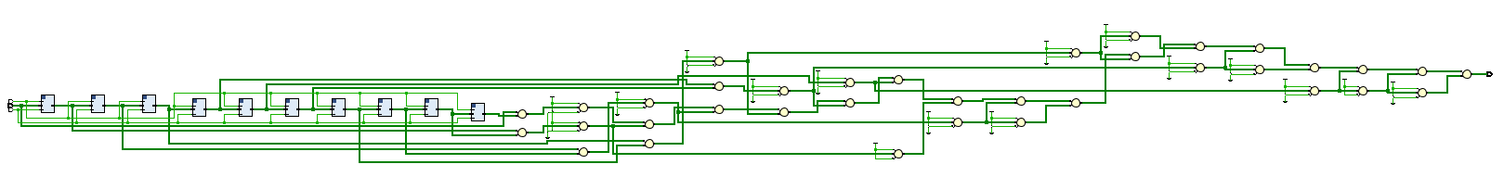
Fig: RTL Schematic of row filter 2

Slide 18
ROW FILTER-3 CSD CODE
 | Filter Coefficients | CSD Representation
H(2, 0) =H(2, 10) | 0.001535744332523 | .00000000+0-0
H(2, 1) =H(2, 9) | 0.002709378181158 | .0000000+0-0-
H(2, 2) =H(2, 8) | -0.004713702487703 | .0000000-0-0+
H(2, 3) =H(2, 7) | -0.005682561923213 | .000000-0+00+
H(2, 4) =H(2, 6) | 0.024649517281923 | .0000+0-00+00
H(2, 5) | 0.048889485737597 | .000+0-00+000

Slide 19
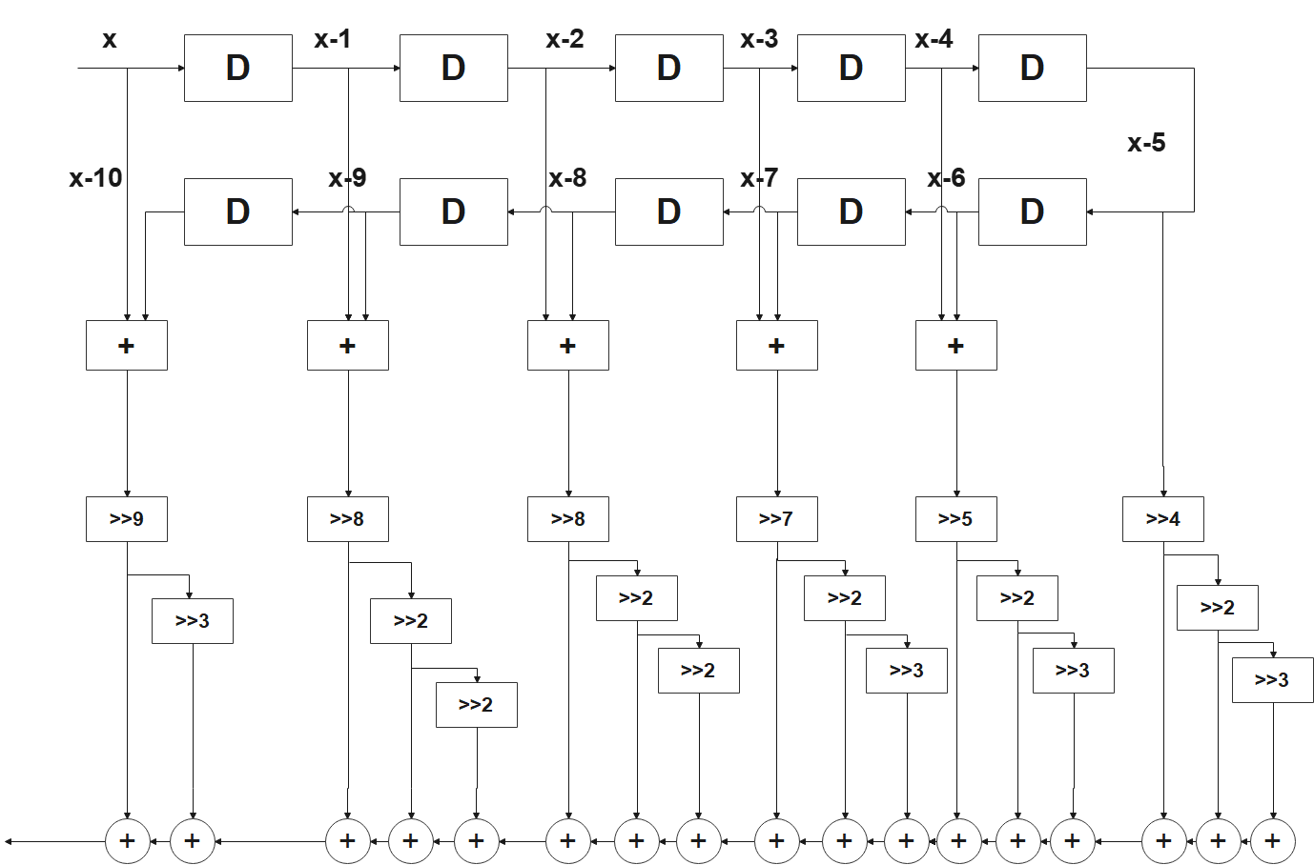
Row Filter 3 : Y = [x+(x-10)]>>9 - [x+(x-10)]>>11 +[(x-1)+(x-9)]>>8 - [(x-1)+(x-9)]>>10 - [(x-1)+(x-9)]>>12 -[(x-2)+(x-8)]>>8 - [(x-2)+(x-8)]>>10 + [(x-2)+(x-8)]>>12 - [(x-3)+(x-7)]>>7 + [(x-3)+(x-7)]>>9 + [(x-3)+(x-7)]>>12 + [(x-4)+(x-6)]>>5 –[(x-4)+(x-6)]>>7 + [(x-4)+(x-6)]>>10 + [(x-5)]>>4 - [(x-5)]>>6 + [(x-5)]>>9
(3.2.3)
Fig: Architecture of FIR filter for row-filter 3

Slide 20
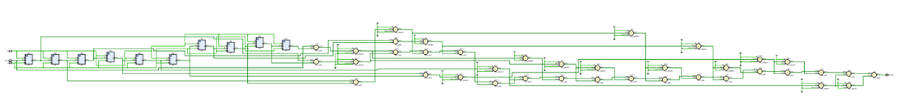
Fig: RTL Schematic of row filter 3

Slide 21
ROW FILTER-4 CSD CODE
 | Filter Coefficients | CSD Representation
H(3, 0) =H(3, 10) | 0.004095318220062 | .0000000+0000
H(3, 1) =H(3, 9) | -0.003315045803642 | .0000000-0+0-
H(3, 2) =H(3, 8) | -0.005682561923213 | .000000-0+00+
H(3, 3) =H(3, 7) | 0.019300146101299 | .00000+0+000-
H(3, 4) =H(3, 6) | -0.027080046645711 | .0000-00+00+0
H(3, 5) | -0.089304781293037 | .00-0+00+0+0-

Slide 22
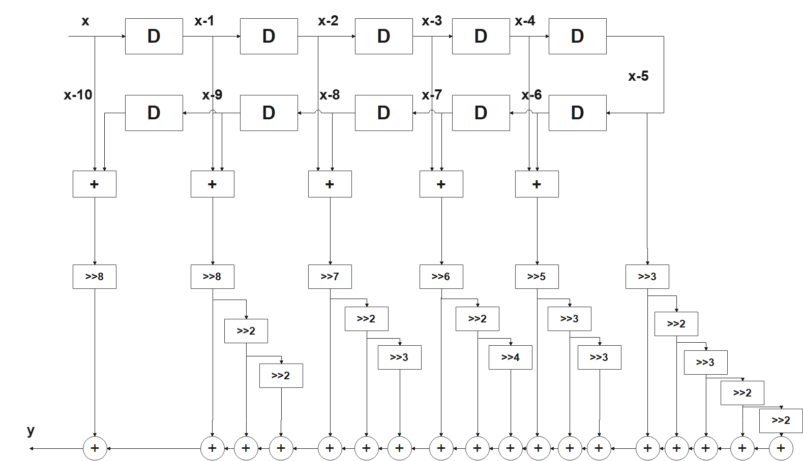
Row Filter 4 : Y = [x+(x-10)]>>8 - [(x-1)+(x-9)]>>8 + [(x-1)+(x-9)]>>10 - [(x-1)+(x-9)]>>12 -[(x-2)+(x-8)]>>7 + [(x-2)+(x-8)]>>9 + [(x-2)+(x-8)]>>12 + [(x-3)+(x-7)]>>6 + [(x-3)+(x-7)]>>8 - [(x-3)+(x-7)]>>12 - [(x-4)+(x-6)]>>5 –[(x-4)+(x-6)]>>8 + [(x-4)+(x-6)]>>11 - [(x-5)]>>3 + [(x-5)]>>5 + [(x-5)]>>8 + [(x-5)]>>10 - [(x-5)]>>12 (3.2.4)
Fig: Architecture of FIR filter for row-filter 4

Slide 23
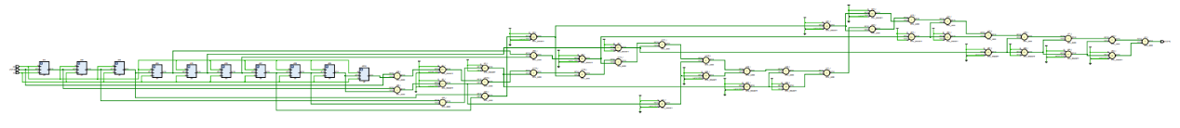
Fig: RTL Schematic of row filter 4

Slide 24
ROW FILTER-5 CSD CODE
 | Filter Coefficients | CSD Representation
H(4, 0) =H(4, 10) | 0.007166806885109 | .000000+00-0+
H(4, 1) =H(4, 9) | -0.016868387157439 | .00000-000-0-
H(4, 2) =H(4, 8) | 0.024649517281923 | .0000+0-00+00
H(4, 3) =H(4, 7) | -0.027080046645711 | .0000-00+00+0
H(4, 4) =H(4, 6) | 0.001990013552999 | .00000000+000
H(4, 5) | 0.155509543046362 | .00+0+0000-00

Slide 25
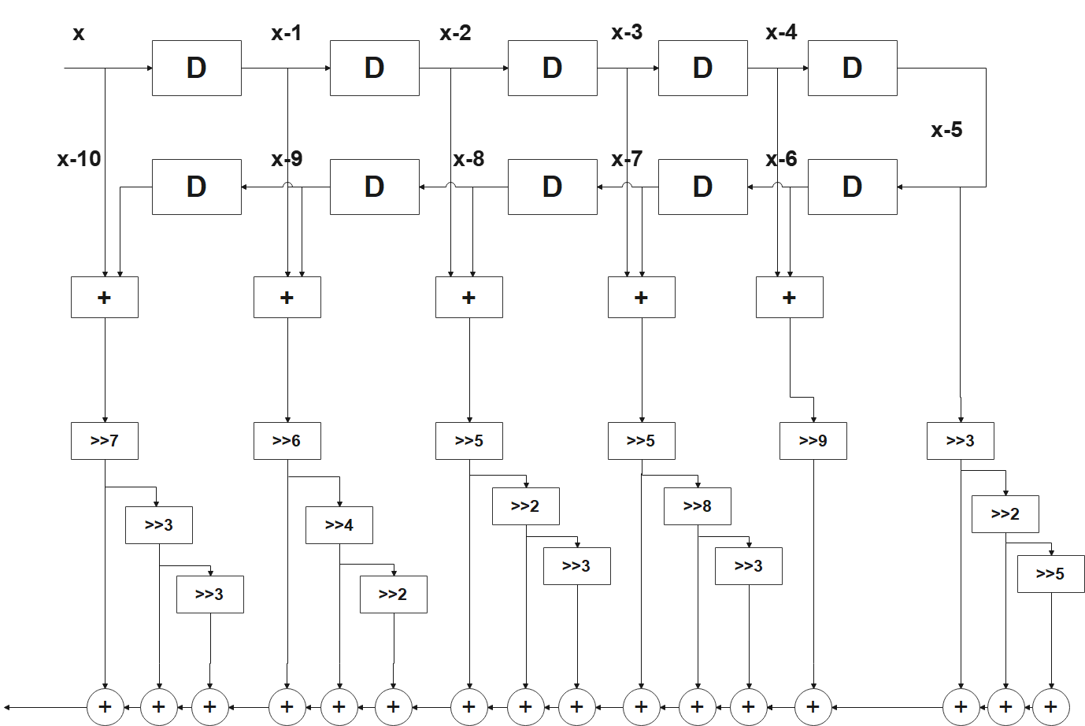
Row Filter 5 : Y = [x+(x-10)]>>7 - [x+(x-10)]>>10 + [x+(x-10)]>>12 - [(x-1)+(x-9)]>>6 - [(x-1)+(x-9)]>>10 - [(x-1)+(x-9)]>>12 + [(x-2)+(x-8)]>>5 - [(x-2)+(x-8)]>>7 + [(x-2)+(x-8)]>>10 - [(x-3)+(x-7)]>>5 + [(x-3)+(x-7)]>>8 + [(x-3)+(x-7)]>>11 + [(x-4)+(x-6)]>>9 + [(x-5)]>>3 + [(x-5)]>>5 - [(x-5)]>>10 (3.2.5)
Fig: Architecture of FIR filter for row-filter 5

Slide 26
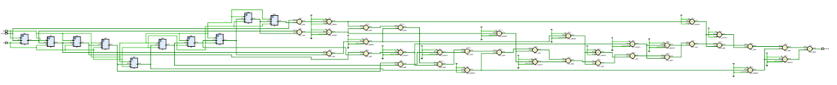
Fig: RTL Schematic of row filter 5

Slide 27
ROW FILTER-6 CSD CODE
 | Filter Coefficients | CSD Representation
H(5, 0) =H(5, 10) | 0.008600168262131 | .000000+00+0-
H(5, 1) =H(5, 9) | -0.024668887389353 | .0000-0+00-0-
H(5, 2) =H(5, 8) | 0.048889485737597 | .000+0-00+000
H(5, 3) =H(5, 7) | -0.089304781293037 | .00-0+00+0+0-
H(5, 4) =H(5, 6) | 0.155509543046362 | .00+0+0000-00
H(5, 5) | 0.659225298223813 | .+0+0+00+0-00

Slide 28
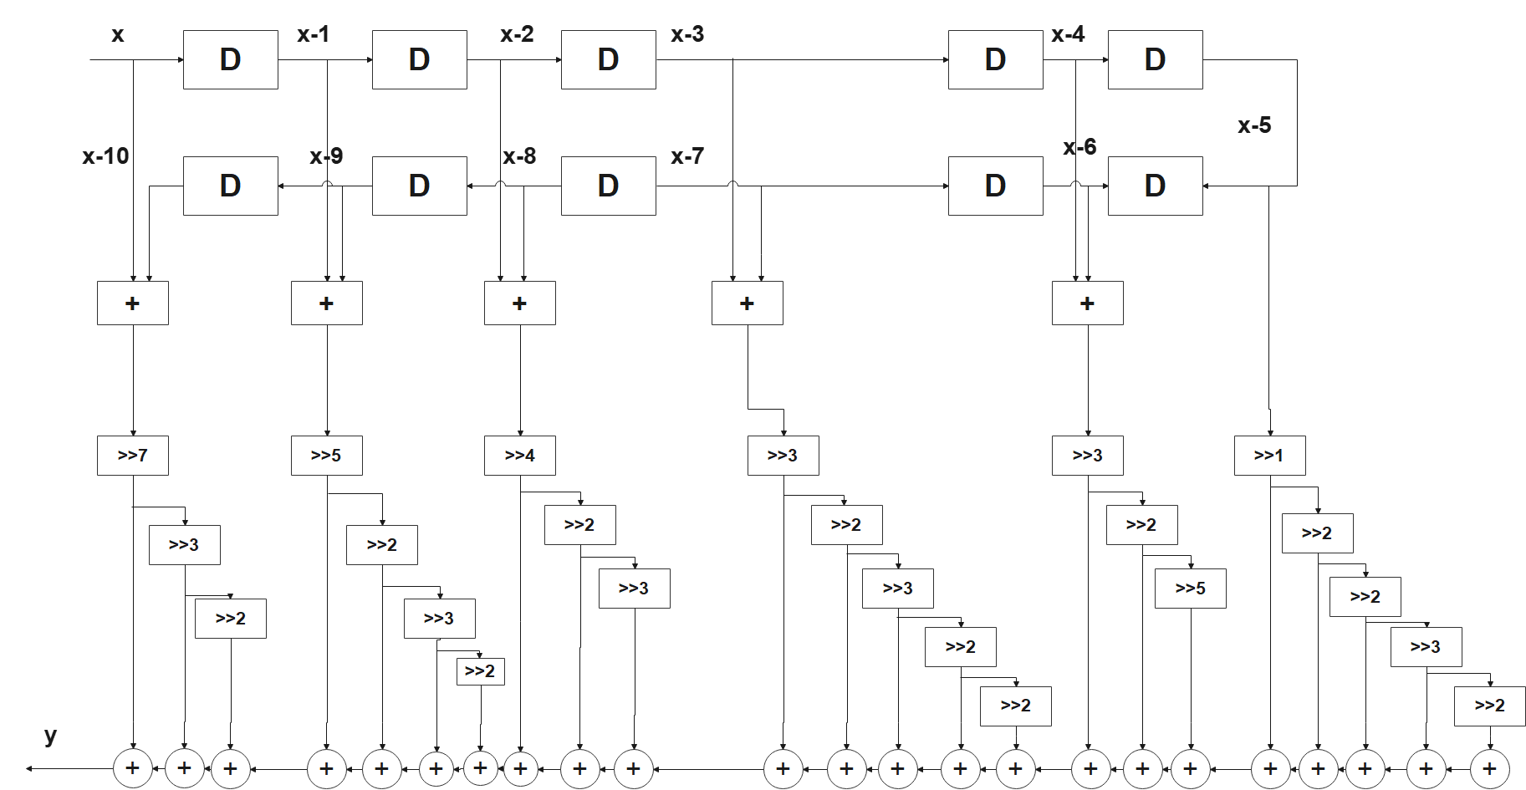
Row Filter 6 : Y = [x+(x-10)]>>7 - [x+(x-10)]>>10 - [x+(x-10)]>>12 - [(x-1)+(x-9)]>>5 + [(x-1)+(x-9)]>>7 - [(x-1)+(x-9)]>>10 - [(x-1)+(x-9)]>>12 + [(x-2)+(x-8)]>>4 - [(x-2)+(x-8)]>>6 + [(x-2)+(x-8)]>>9 - [(x-3)+(x-7)]>>3 + [(x-3)+(x-7)]>>5 + [(x-3)+(x-7)]>>8 + [(x-3)+(x-7)]>>10 - [(x-3)+(x-7)]>>12 + [(x-4)+(x-6)]>>3 + [(x-4)+(x-6)]>>5 - [(x-4)+(x-6)]>>10 + [(x-5)]>>1 + [(x-5)]>>3 + [(x-5)]>>5 + [(x-5)]>>8 - [(x-5)]>>10 (3.2.6)
Fig: Architecture of FIR filter for row-filter 6

Slide 29
Fig: RTL Schematic of row filter 6

Slide 30
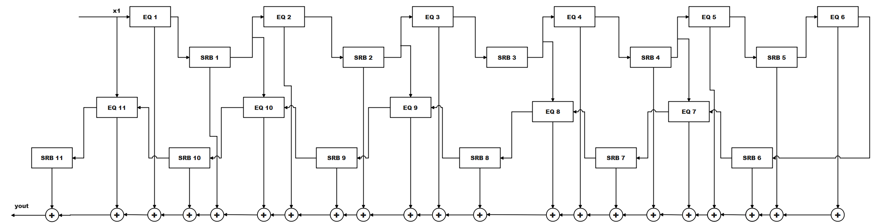
FIR FILTER USING SHIFT REGISTER BLOCKS
Then the row filters are integrated using shift register block.
The architecture of the 2D FIR filter with shift register blocks is represented below
Fig: Architecture of FIR filter using shift register blocks.

Slide 31
RTL SCHEMATICS OF SHIFT REGISTER BLOCK
Fig: Shift Register Block Architecture for 64 words

Slide 32
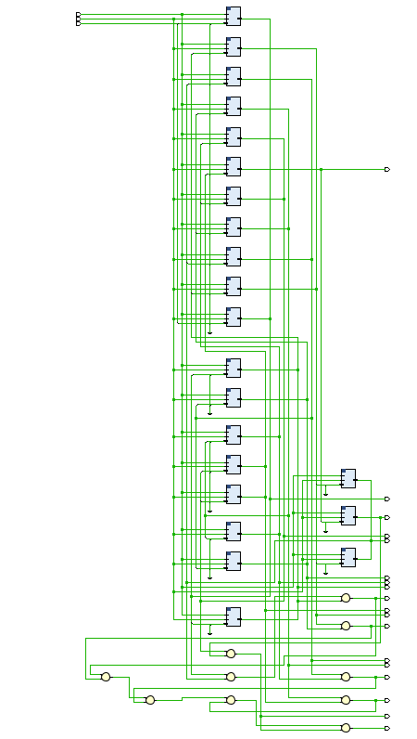
RTL Schematic of 2D FIR filter

Slide 33
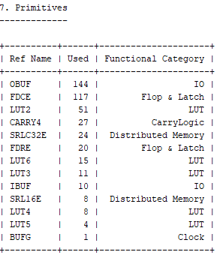
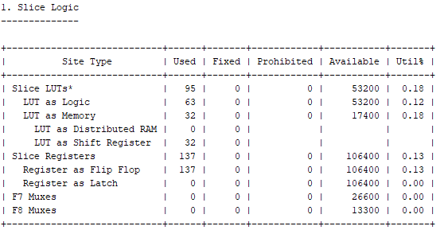
PERFORMANCE ANALYSIS AND RESULTS

Slide 34
ASIC Synthesis Results
Comparison of ASIC design-based VLSI design metrics of 2-D FIR filter in different architectures using Genus synthesis tool from Cadence in 45 nm
Type of coefficients | architecture | 8-bit filter input |  |  | 16-bit filter input
 |  | Area (µm²) | Power (mW) | Delay (ns) | Area (µm²) | Power (mW) | Delay (ns)
Continuous Coefficients | Fully-Direct | 89010 | 34.8 | 9.05 | 189543 | 51.002 | 18.00
CSD | Fully-Direct | 3109 | 2.1803 | 6.28 | 16239 | 5.1358 | 16.56

Slide 35
ASIC Synthesis Results
Synthesis results comparison of the proposed 2-D FIR filter architectures with state-of-the art works.
Architectures | N | Area (µm²) | Power (mW) | Delay (ns) | ADP (µm^{2 .}ms) | PDP (µm^{2 .} mW)
Kumar et al. [42] | 8 | 651615 | 20.1069 | 6.53 | 0.531880 | 131.3
Mohanty et al. [43] | 8 | 1720962 | 50.0106 | 11.79 | 25.37555 | 589.62
Khoo et al. [31] | 8 | 356293 | 9.3807 | 13.1 | 4.636084 | 122.89
Chen et al. [44] | 9 | 22359 | 9.356 | 19.23 | 0.429963 | 179.91
Proposed 1 (Fully-Direct) | 11 | 16239 | 5.1358 | 16.56 | 0.268917 | 85.04

Slide 36
Power – Delay Comparison

Slide 37
Area Delay Product

Slide 38
Power Delay Product

Slide 39
TOOLS USED
MATLAB
XILINX VIVADO
CADENCE Genus Tools

Slide 40
Conclusion
A 2D FIR filter coefficients are generated using MATLAB and those coefficients are transformed into CSD bits.
Filter architectures are designed using CSD bits and architectures are integrated using shift register blocks.
VLSI architectures are implemented and synthesis reports are generated using Vivado tool.
Area, Power and Delay are generated using Cadence Genus tool.
Obtained 2D FIR filter which yielded an optimized area of up to 91%and delay of up to 8%.

Slide 41
REFERENCES
Mohanty B. K., Meher P. K., Al- Maadeed S., & Amira, A. (2013). Memory footprint reduction for power-efficient realization of 2-D finite impulse response filters. IEEE Transactions on Circuits and Systems I: Regular Papers, 61(1), 120–133.
Chandra, A., & Chattopadhyay, S. (2016). A new strategy of image denoising using multiplier-less FIR filter designed with the aid of the differential evolution algorithm. Multimedia Tools and Applications, 75(2), 1079–1098.
Das, P., Naskar, S. K., & Narayan Patra, S. (2019). Fast converging cuckoo search algorithm to design symmetric FIR filters. International Journal of Computers and Applications, 1–19.
Bindima, T., & Elias, E. (2019). Low-complexity 2-D digital FIR filters using polyphase decomposition and farrow structure. IEEE Transactions on Circuits and Systems I: Regular Papers, 66(6), 2298–2308.
Odugu, V. K., Venkata Narasimhulu, C., & Prasad, K. S. (2019). Implementation of low power and memory efficient 2D FIR filter architecture. International Journal of Recent Technology and Engineering, 8(1), 927–935.

